Slide 1
ONLINE COLLEGE COUNSELLING
SITE
PRESENTED BY:
KUNTAL NASKAR
ROHAN GHOSH
UNDER THE GUIDANCE OF,
MR. SASWATA CHATTERJEE
State Aided College Teacher,
Surendranath College
University Of Calcutta

Slide 2

INTRODUCTION:
Online college counselling systems have been used widely by colleges & students all around the world.
The one-stop solution provides technical support and services towards a hassle-free admission process in Academic Institutions across the country.
It is an initiative that makes Admissions in academic institutions simple, accessible to all, at anytime and anywhere.
Our Online College Counselling is one of the best opportunities for those who cannot know about the admission process of the college and booked their suitable course. Students can book their course online at particular time of college.

Slide 3
AIM OF THE PROJECT
To visit a website in GOGGLE or web-browser we have to chance for all people to communicate all educational centre by the medium of our software.
In sometimes so many people harassed to admission when he passed out Higher secondary examination.Our software soluted this problem in short distance of time.
So we try to this website doing its work smoothly,quickly,and spend at low amount of data.So many new features of the educational system are provide by our software.
Those people who are poor ,who’s ability is don’t pay extra money for the pupose.Then who can used our software and he will benifitted. It is also a user friendly software.

Slide 4
FEATURES OF ONLINE COLLEGE COUNSELLING SITE
To solve the problems mentioned earlier online college counselling site a lot of features which are:
You can select your college where you like to admission.
You can take admission in college or some other educational centre through our website just by some clicks.
You can see all of the other colleges are available in India.and also process of take admission into this college are fully explained it.
You can see details of all college ,their grade,there teachers details,there population of students,and also their aligibility to take admission.
You can check also their current status.
Our website provide all the student who used our website they also create their own profile in it.
Our website also mentioned what is the right choice between your profile .
In this website all time updated through the colleges and also students thought.

Slide 5
COMPONENTS USED
As we mentioned earlier ONLINE COLLEGE COUNSELLING SITE is website that which can be accessed from any
Desktop/PC/mobile.So to built versatile website like this we have a better idea about the components we categorized it into two parts which are:-
FRONT-END:
A. HTML
B. CSS
C. JAVA-SCRIPT
BACK-END:
XAMPP SERVER
MYSQL

Slide 6
DATA FLOW DIAGRAM(DFD):
0 LEVEL DFD-
COLLEGE SEARCH
LOGIN MANAGEMENT
GENERATE COLLEGE DETAILS
STUDENT MANAGEMENT
GENERATE COURSE DETAILS
COUNSELLING
WORLD
COLLEGE MANAGEMENT
GENERATE STUDENT DATA
COURSE MANAGEMENT
GENERATE EMAIL CONFIRMATION

Slide 7
1 LEVEL DFD-
COUNSELLING WORLD
GET REGISTRATION AND APPLY CONFIRMATION BY E-MAIL
VIEW STUDENT DETAILS
SUBMIT FEEDBACKS
VIEW FEEDBACKS
REGISTRATION
STUDENT
LOGIN
ADMIN
APPLY COLLEGES
VEIW PROFILE
REGISTER COLLEGES
ASSIGN AND MANAGE
RANK WISE COLLEGE SUGGESTION
VIEW COLLEGE DETAILS
MANAGE COLLEGES
ASSIGN DEGREES AND RANK
MANAGE DEGREE
COLLEGE
MANAGE COLLEGE FACALTIES
ADD FACULTIES
APPROVE STUDENTS
REJECT STUDENTS
APPLIED STUDENT DETAILS

Slide 8
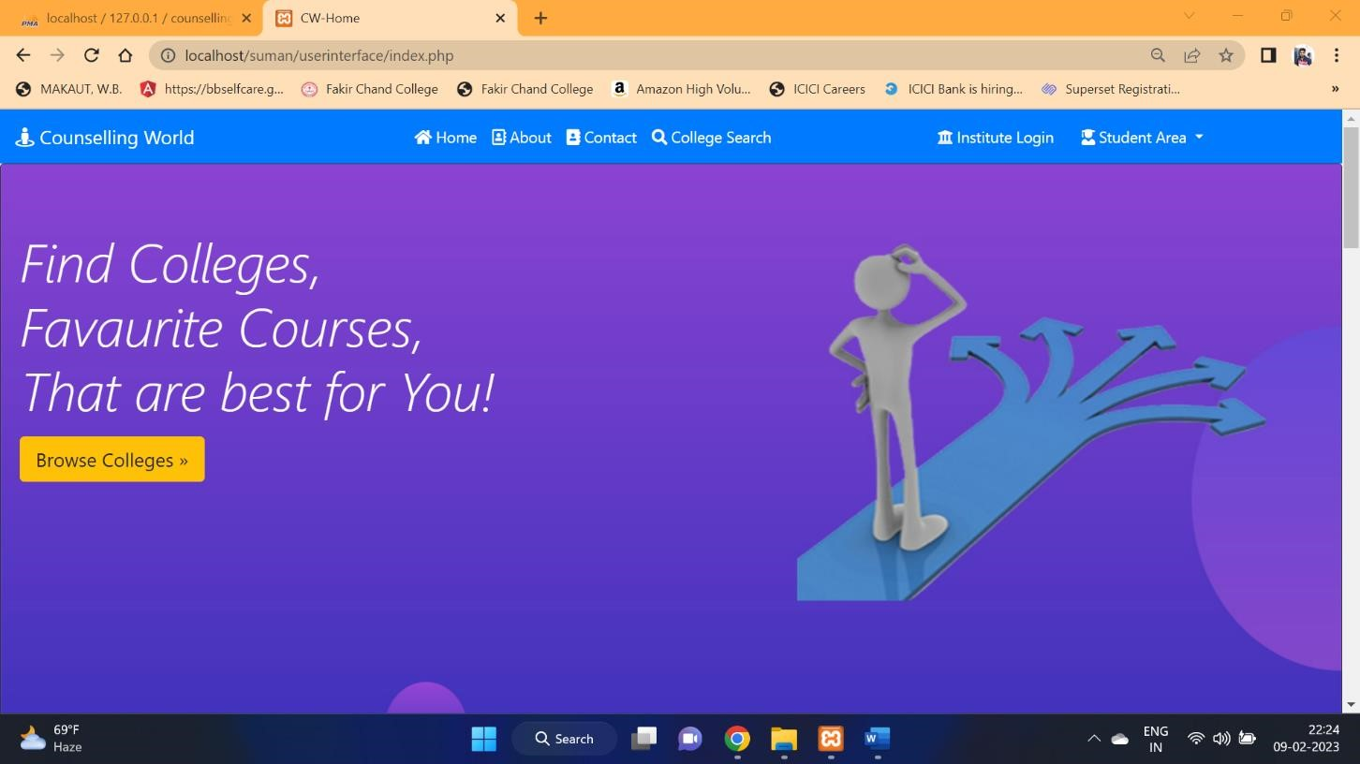
Frontend Home Page:

Slide 9
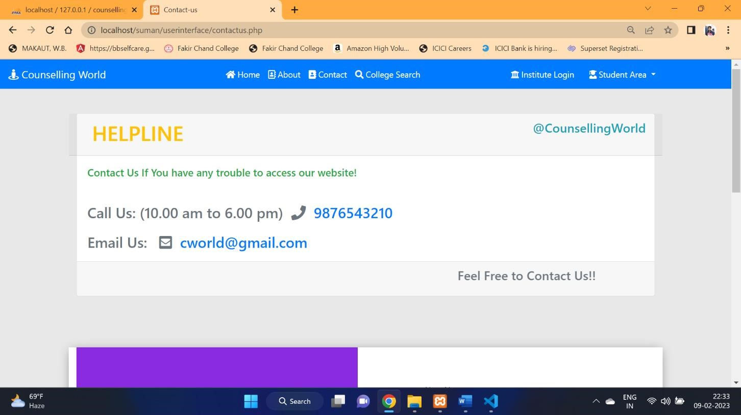
Contact Page :

Slide 10
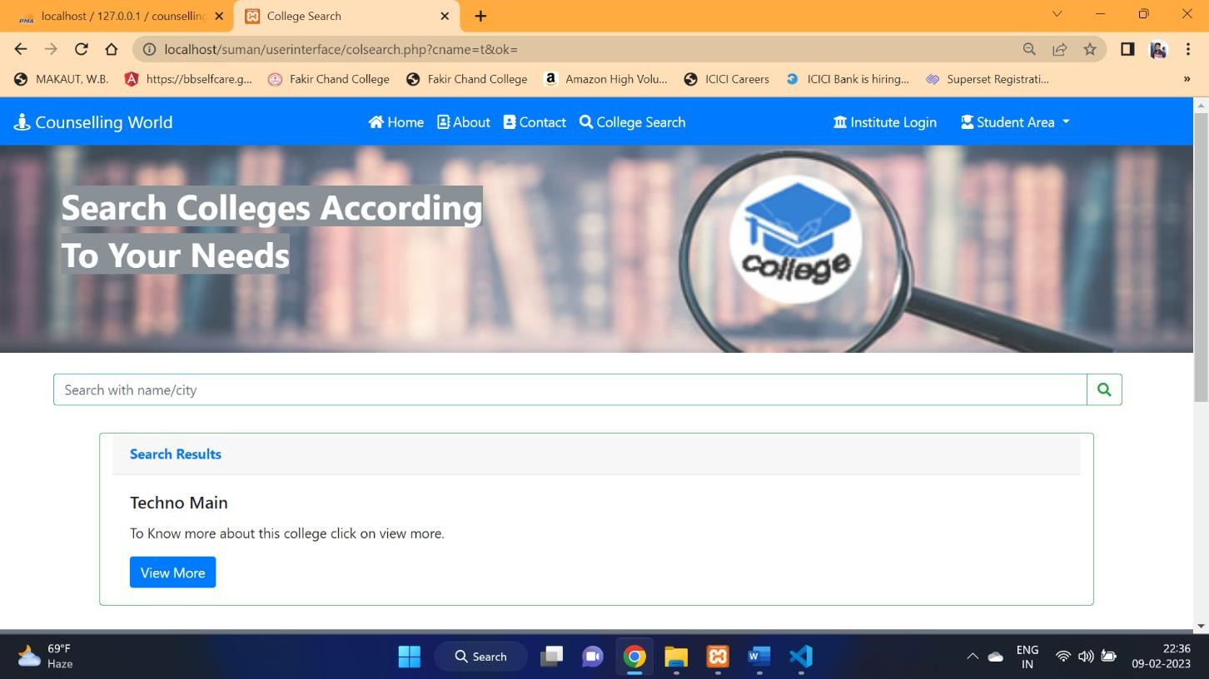
College Search Page :

Slide 11
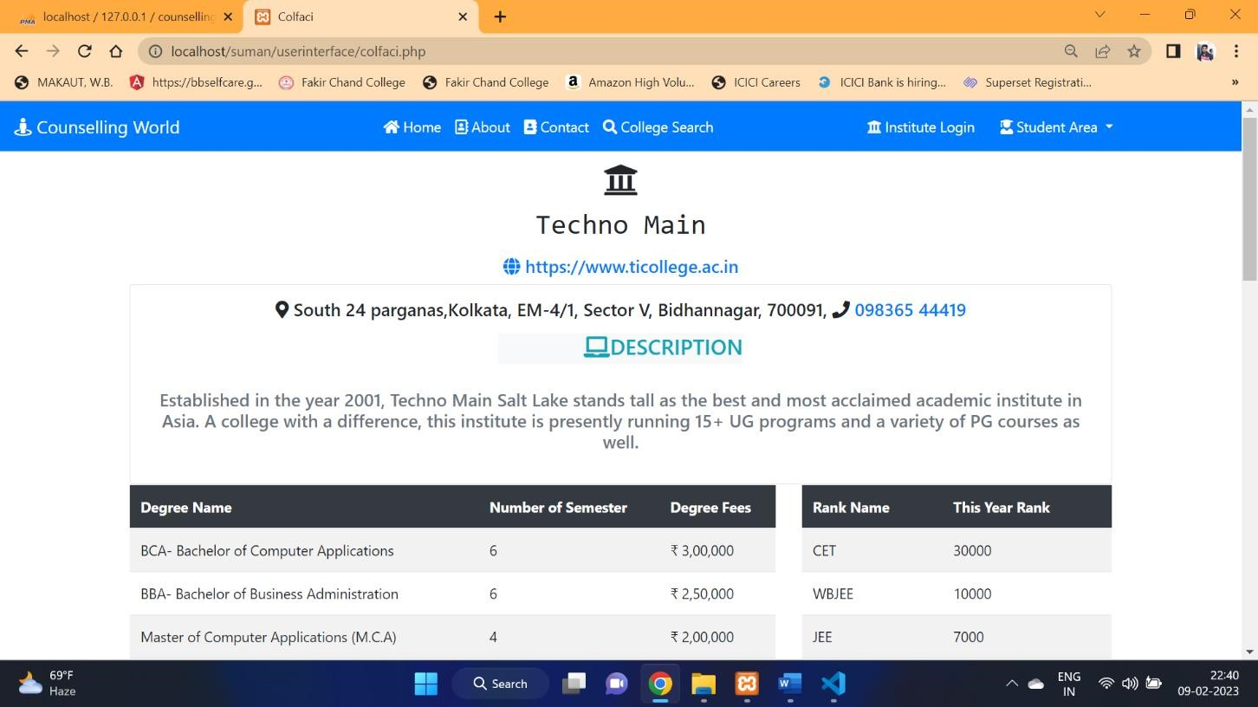
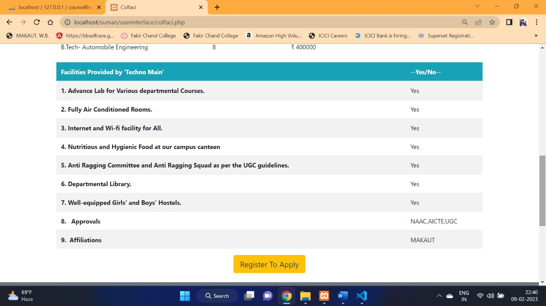
College Details Page(Before Login):

Slide 12
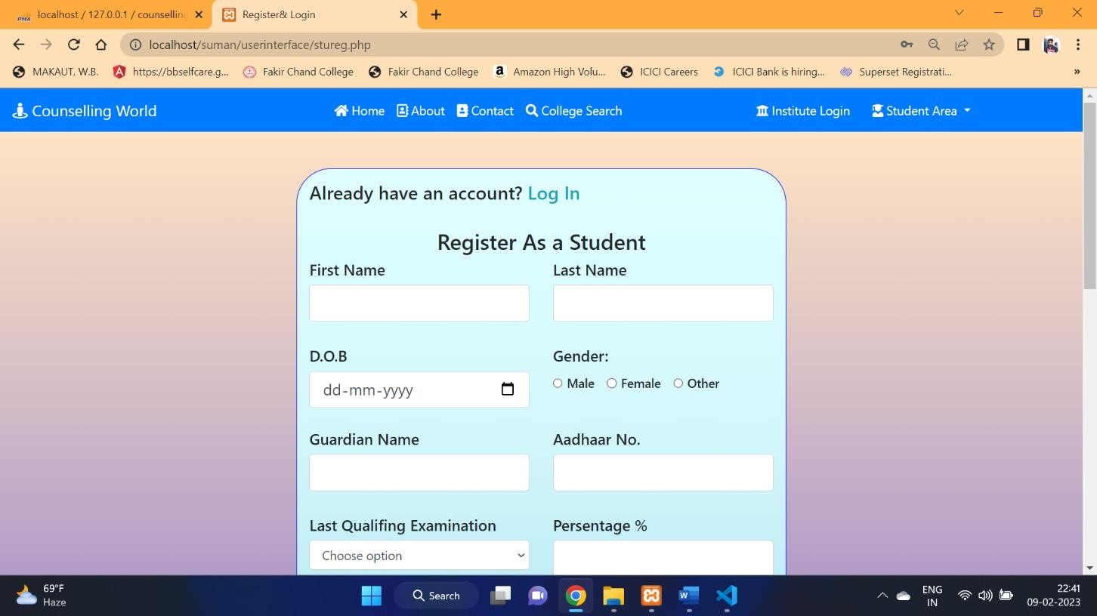
Student Register Page :

Slide 13
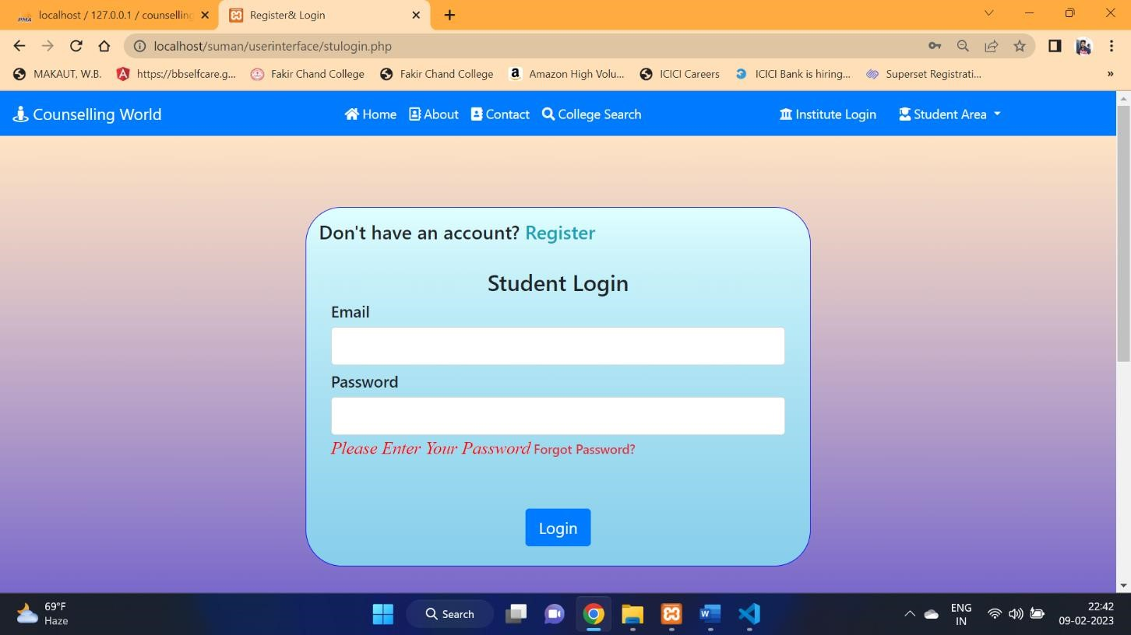
Student Login Page:

Slide 14
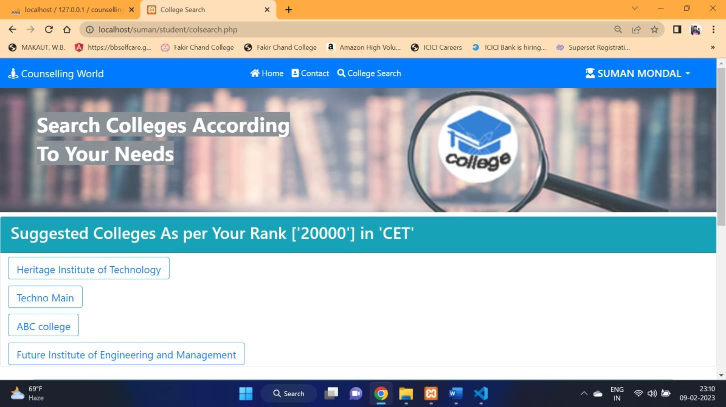
College Search Page (After Login a Student):

Slide 15
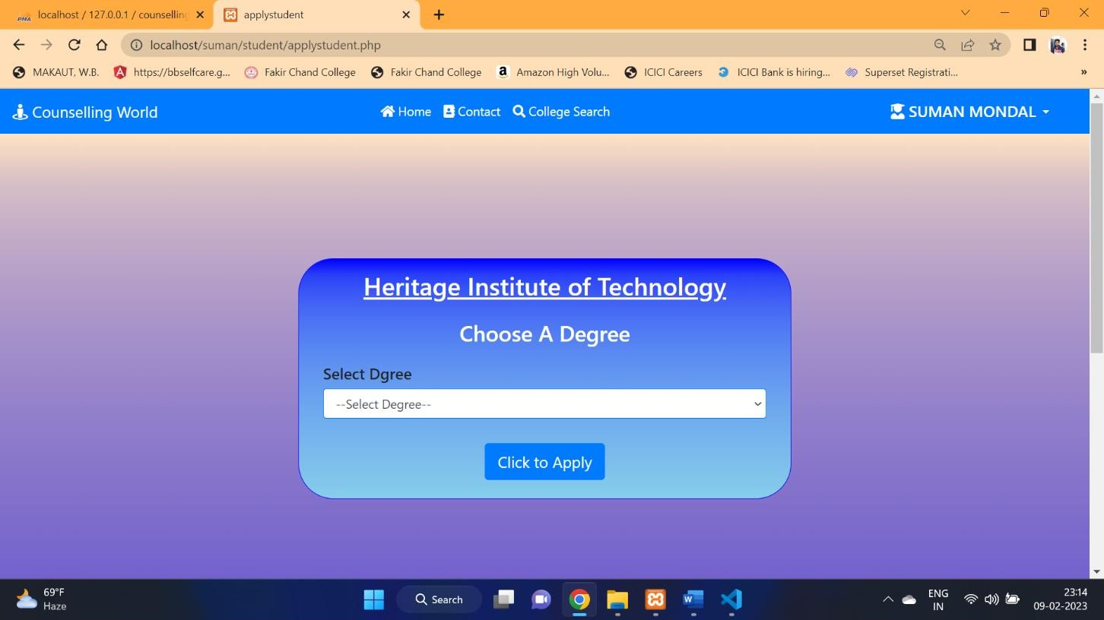
Apply Degree Page :

Slide 16
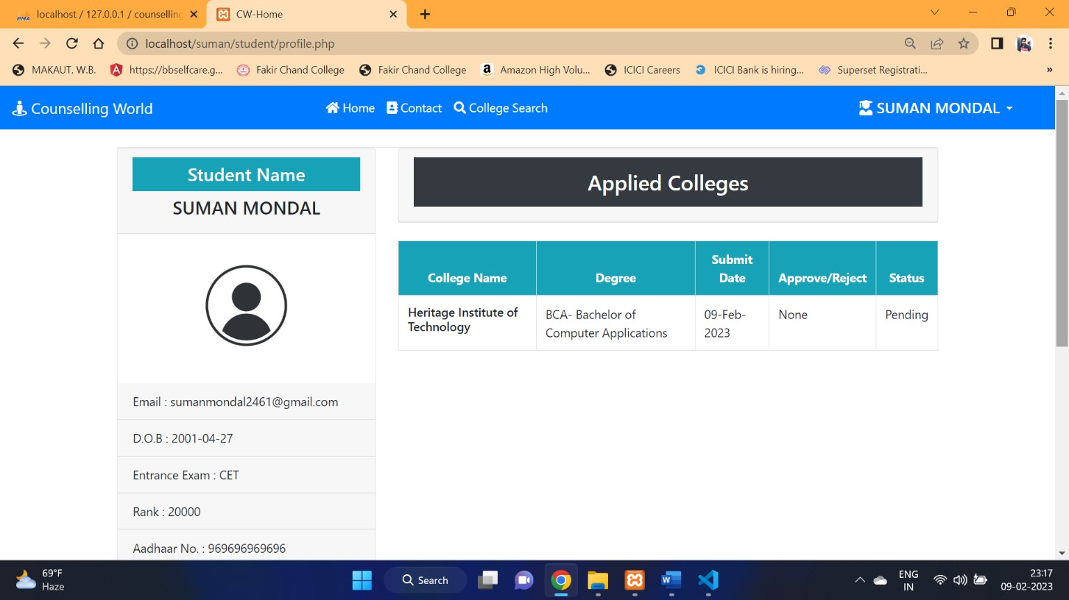
Student Profile Page :

Slide 17
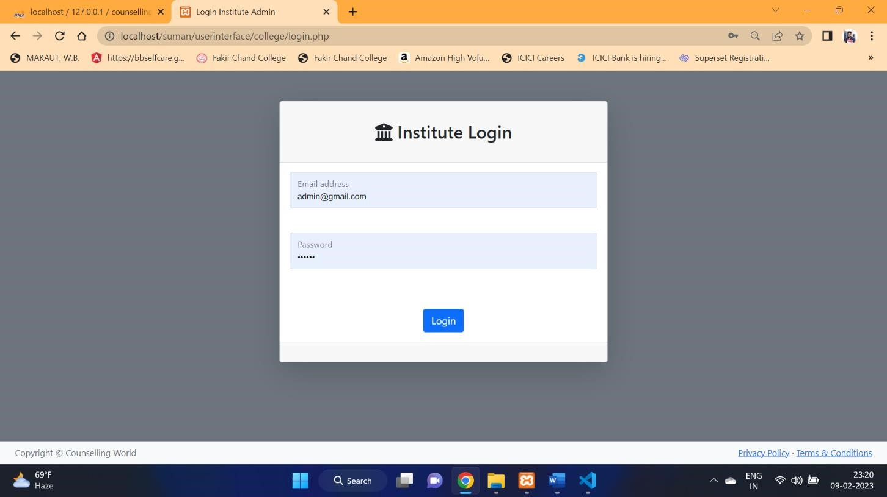
College Login Page :

Slide 18
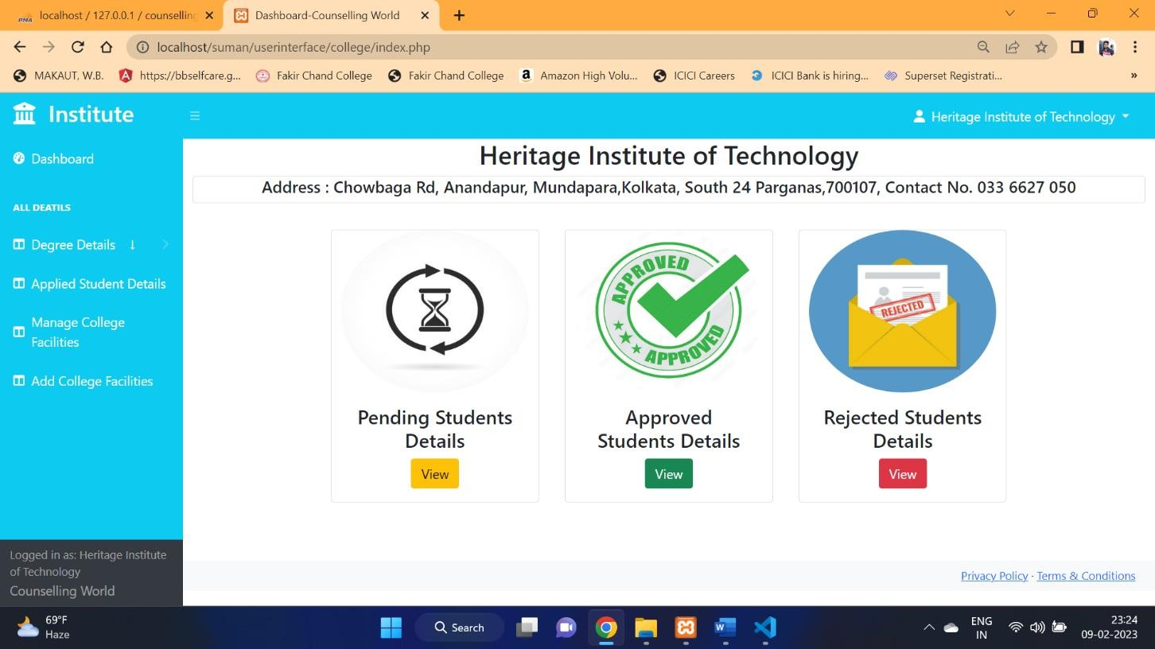
College Dashboard Page :

Slide 19
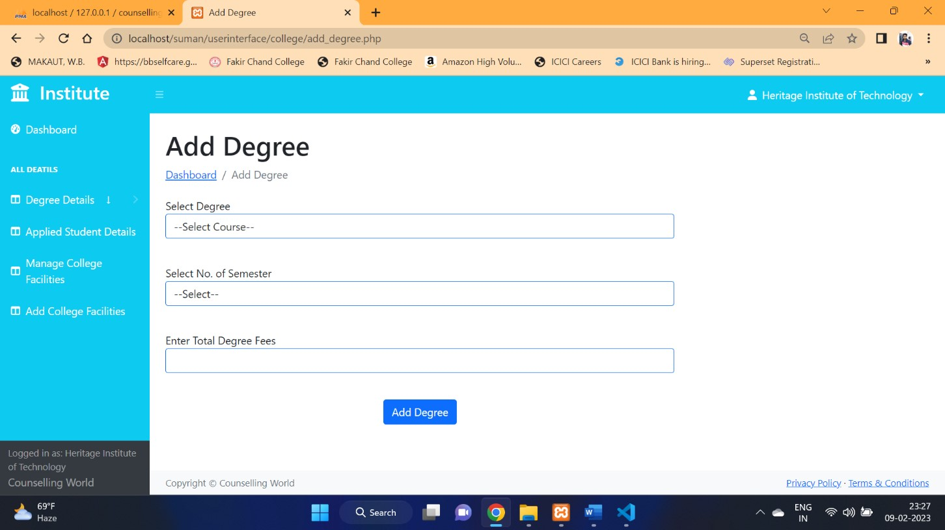
Add Degree Page :

Slide 20
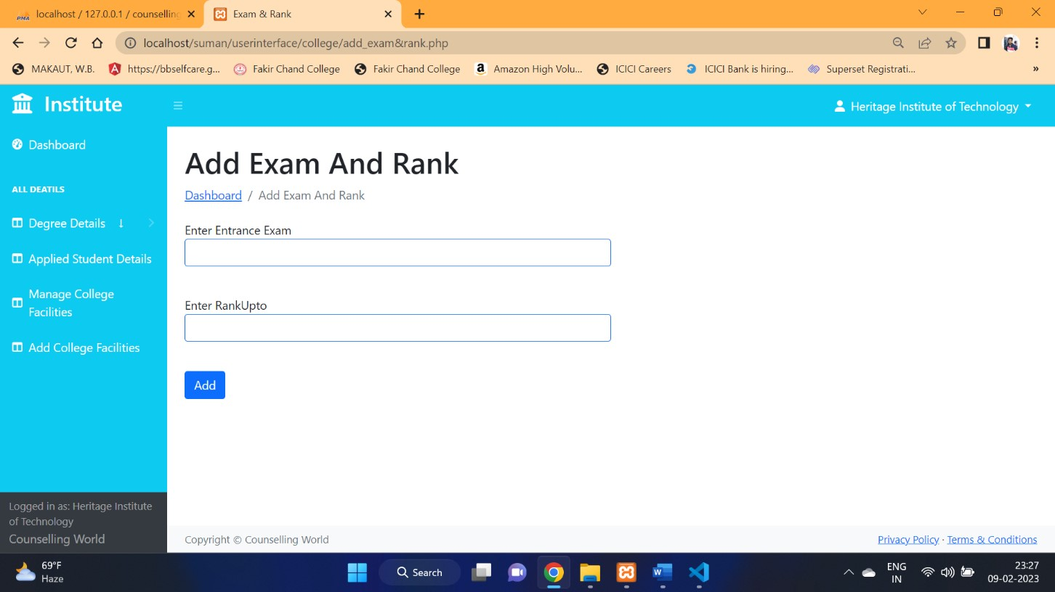
Add Exam and Rank Page:

Slide 21
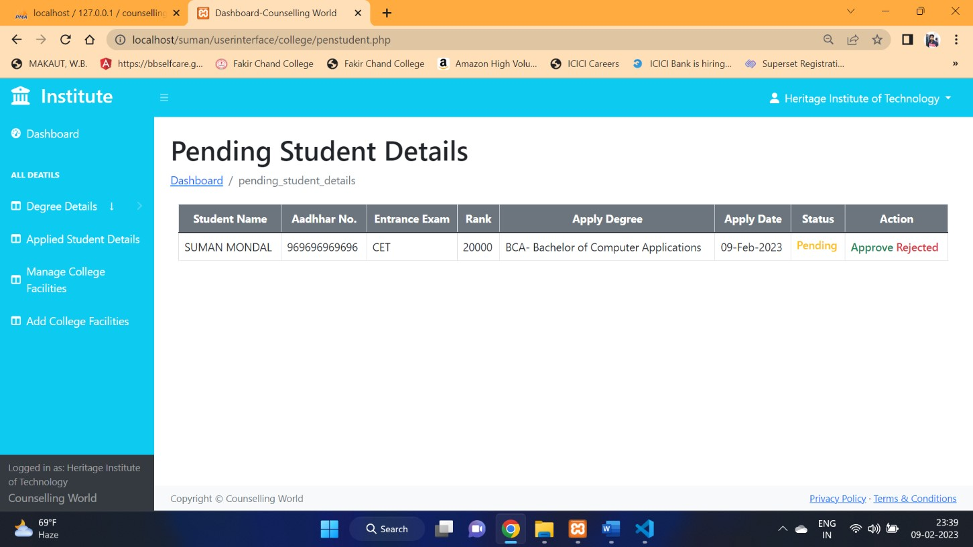
Pending Student Details Page:

Slide 22
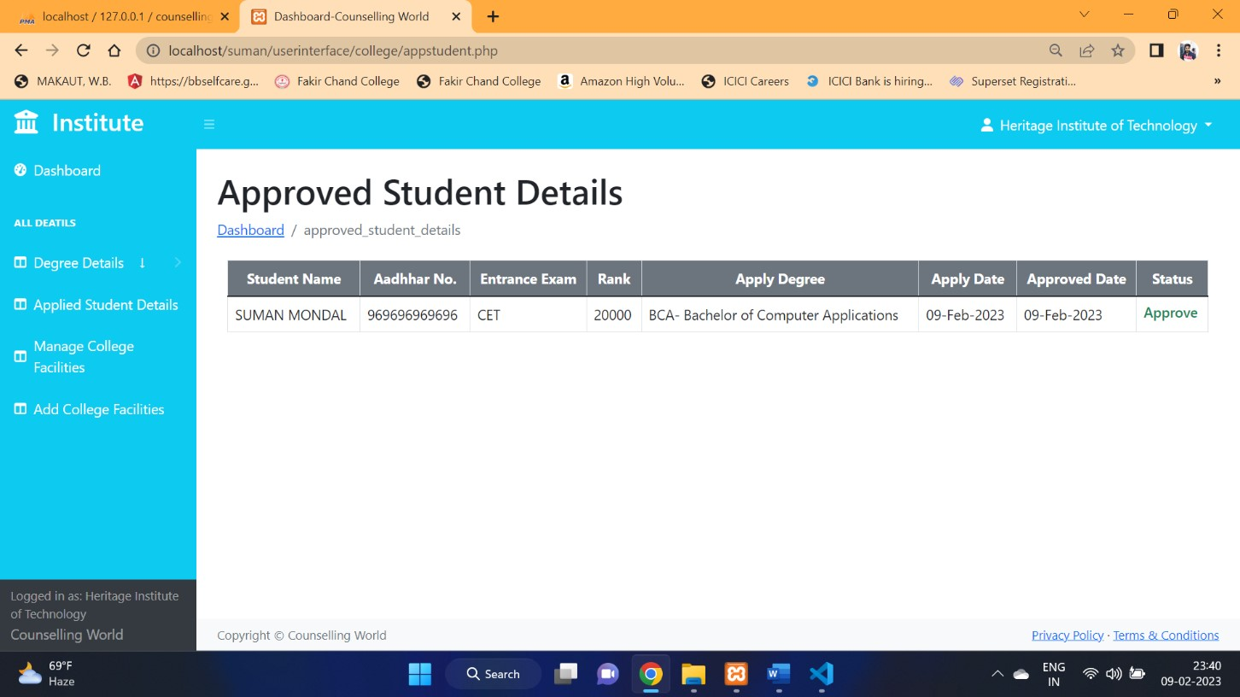
Approved Student Details Page:

Slide 23
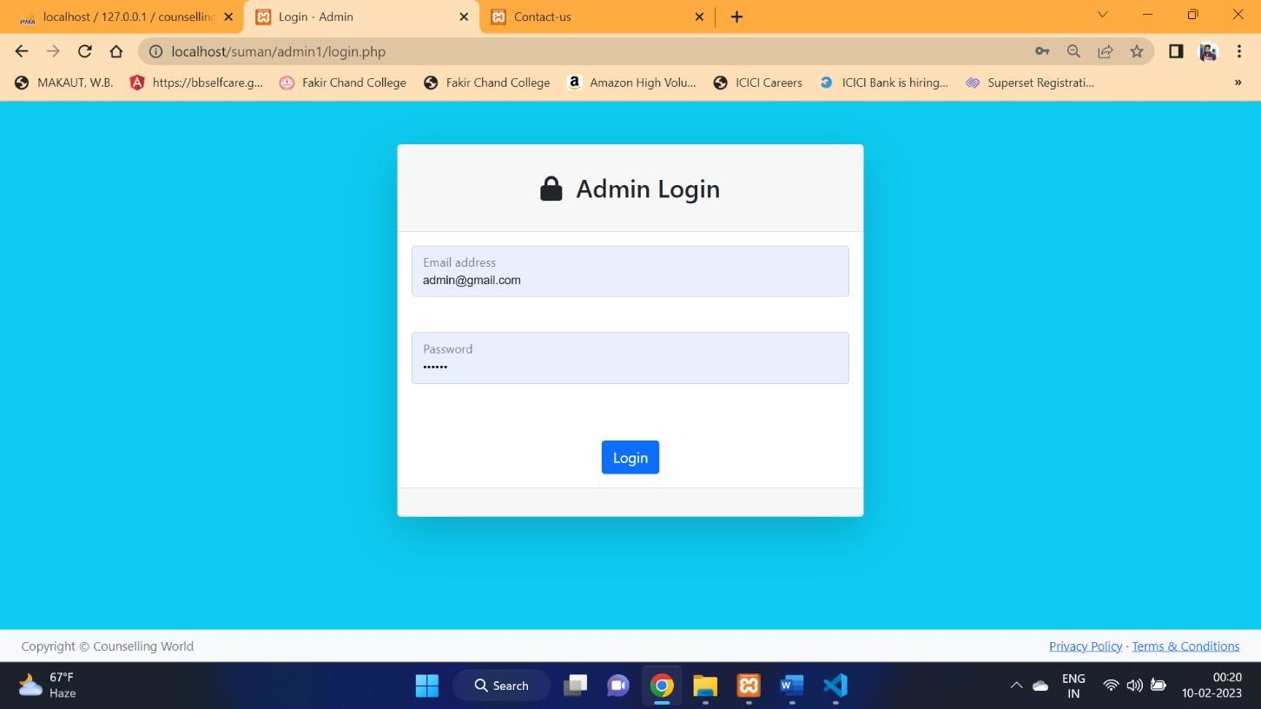
Admin Login page:

Slide 24
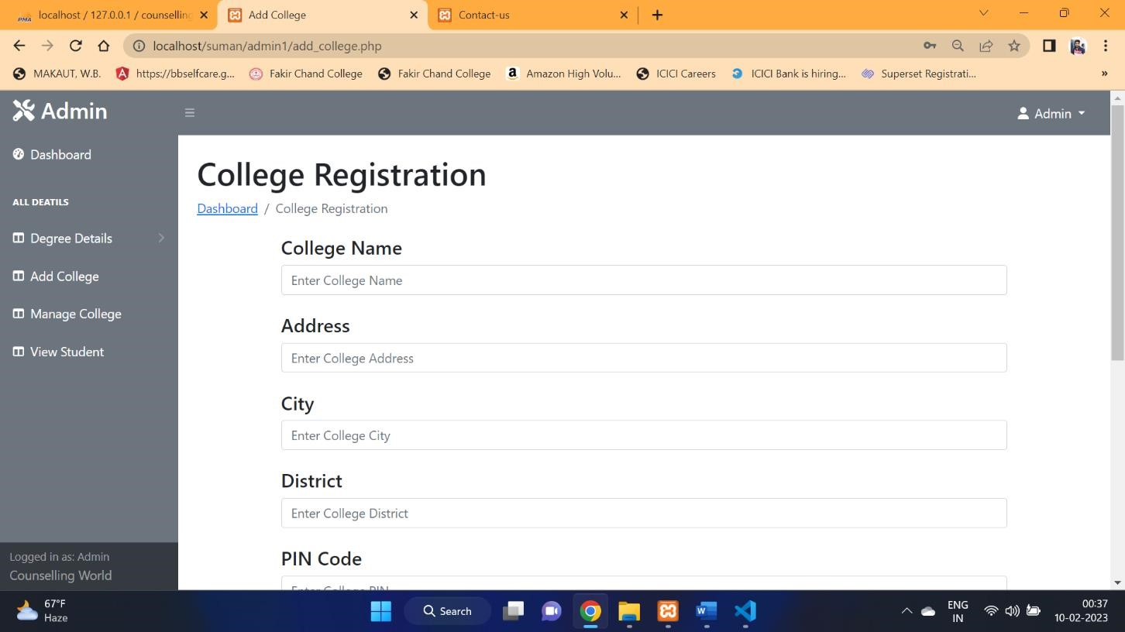
College Registration Page :

Slide 25
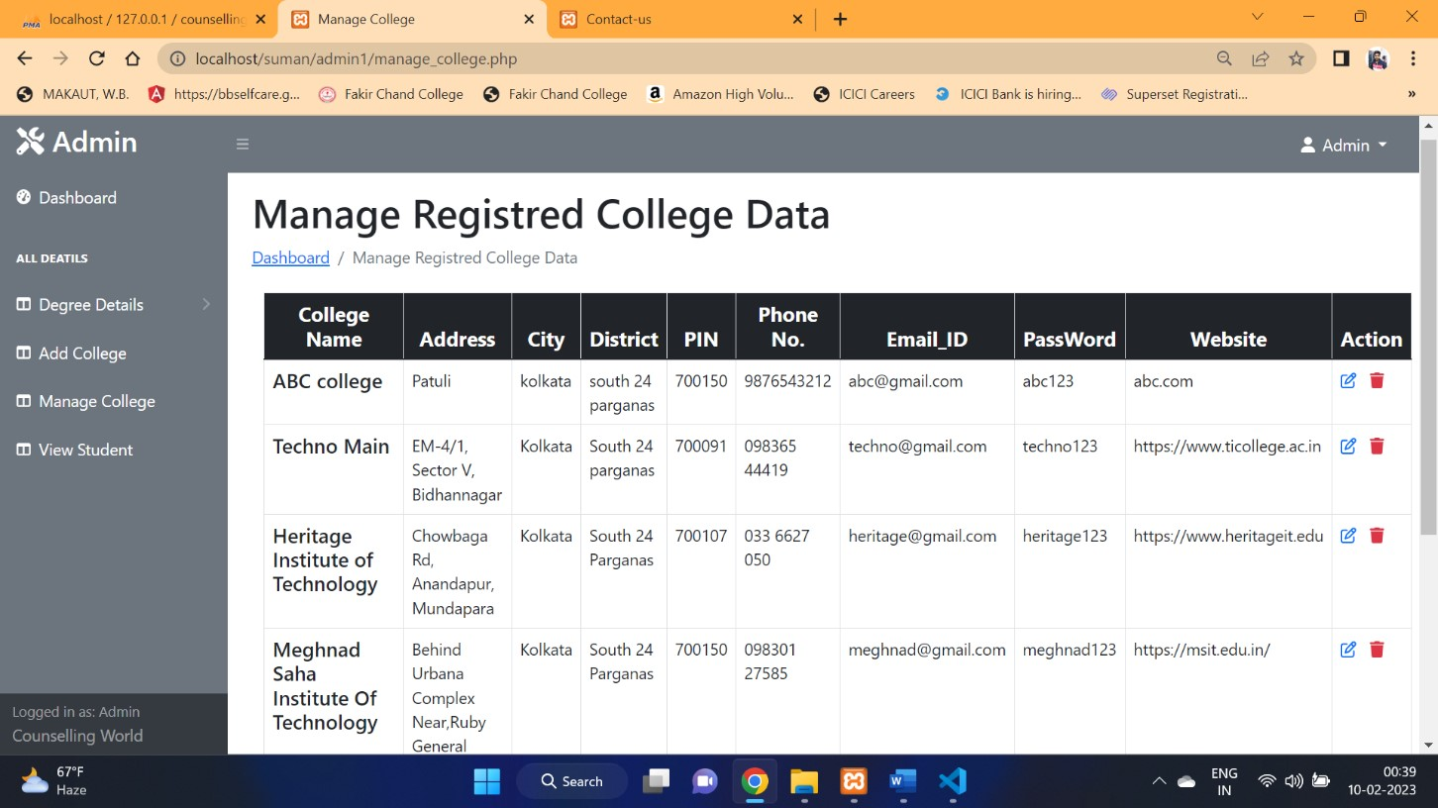
Manage Registered College Page :

Slide 26

Advantage of our project
Anytime anywhere booking.
Multiple packages.
Less business cost.

Slide 27
FUTURE SCOPE
Having so many advantages we must discuss the future potential that Online College Counselling Site has to offer.we believe Online College Counselling Site has so many potential that we can add
into it as the time goes which are:-
We can add home to home facility in this website.
We can add features like to take process of admission through being in your house.
We can add a enquiry portion that anyone can have a enquiry and get their answer by the portion of this website.
We can add features like any problem about the student information through this website can solved it.
We can add the features which is gurdians of the student can easily talk to the college about any enquiry or something through this website.

Slide 28

Limitation of our project
No internet no booking.
No custom package.

Slide 29


Slide 30
THANK YOU

